Slide 1
Learning Java
Durban Session 2018
Dennis Löhmann / Eva Kullová
by South Africa Challenge

Slide 2
First things first... Who are we?
Dennis Löhmann
Computer Scientist at Lufthansa Industry Solutions in Hamburg
Experience in Java, Angular and Blockchain
Eva Kullová
Corporate Lawyer at Railway Company in Hamburg, Germany
Experience in Contract Management and Data Security

Slide 3
Chapter 1
Starting with Java
What is Java?
Install Software
Write your first Program
Data Types
Methods and Parameters
User Input

Slide 4
More Resources for learning
Find this on GitHub: https://github.com/dloehmann/Java-Boot-Camp
https://www.tutorialspoint.com/java/index.htm
https://www.javatpoint.com/java-tutorial
https://m.youtube.com/watch?v=3u1fu6f8Hto
https://www.codecademy.com/learn/learn-java
https://www.udemy.com/java-tutorial/
https://www.guru99.com/try-java-editor.html

Slide 5
Lesson 1.1
What is Java?
Java is a programming language and computing platform first released by Sun Microsystems in 1995.
There are lots of applications and websites that will not work unless you have Java installed, and more are created every day. Java is fast, secure, and reliable. From laptops to datacenters, game consoles to scientific supercomputers, cell phones to the Internet, Java is everywhere!
It is used by 90% of the Fortune 500 Companies.
Java is platform –independent, has a good failure safety and is easy to learn.

Slide 6
Lesson 1.1
What is Java?
Java is platform –independent ...
Java is a true programming language, that means it is compiled into bytecode before you can run it (JavaScript is a completely different thing: it runs in the browser and is interpreted during runtime – interpreted languages are slower). Java runs on a Virtual Machine, that provides an adapter to the operating system.
... has a good failure safety ...
You won‘t get a segmentation fault, but an exception that you can catch and handle. Also the Java VM does all the memory management for you. A module called garbage collector cleans up the memory for you
... and is easy to learn.
So why not start today? Java and the IDE Eclipse can be downloaded for free!

Slide 7
Lesson 1.2
Install Eclipse
Download Eclipse from http://www.eclipse.org/downloads/
Unpack the package and start eclipse.exe
Download latest Java JDK from Oracle
Set Path Variable JAVA_HOME

Slide 8
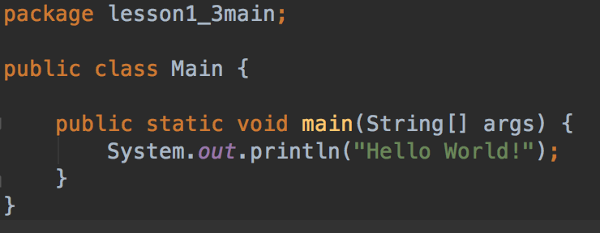
Lesson 1.3
Your first program
Minimum program needs:
package: directory structure class: base datatype in Java main method: always executed at start
System.out.println() prints to the console

Slide 9
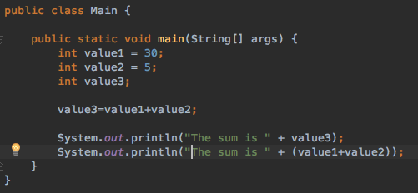
Lesson 1.4
Data Types: Integer
Integer values represent numbers
to declare a variable, use the following format: <type> <name> = <value>
variable names start with a small letter

Slide 10
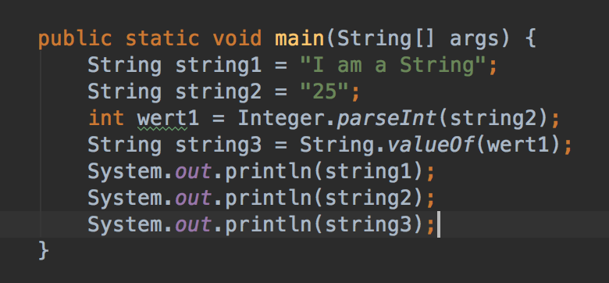
Lesson 1.5
Data Types: String and Typecasting
Strings represent a text data type
Other data types can be converted to String or parsed from Strings.

Slide 11
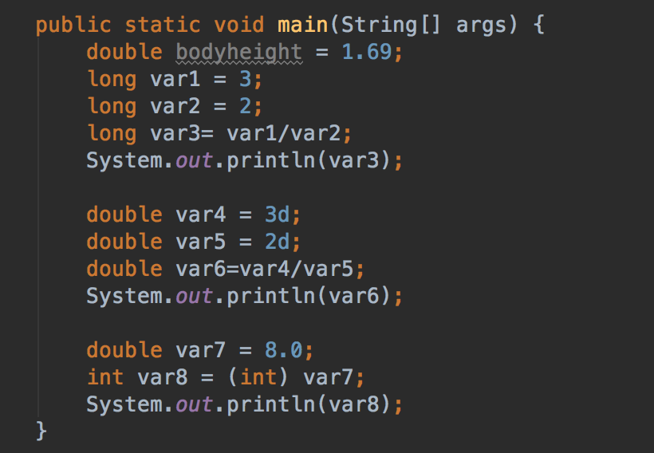
Lesson 1.6
Data Types: Double and others
Doubles are Floating-Point numbers. Can be used for more precision

Slide 12
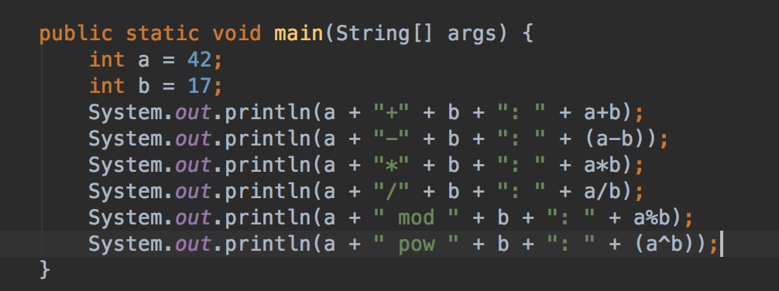
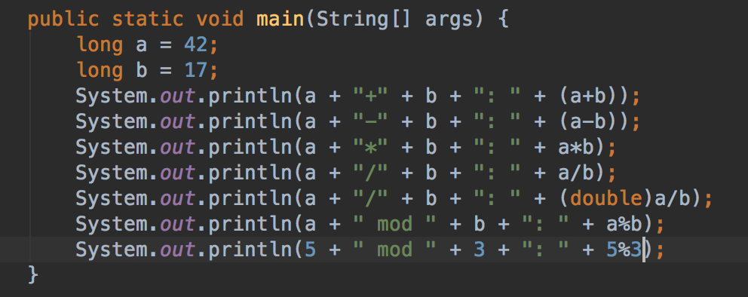
Lesson 1.7
Mathematical Operations
+ addition - minus / division * multiplication
% (called Modulo) calculates the division remainder

Slide 13
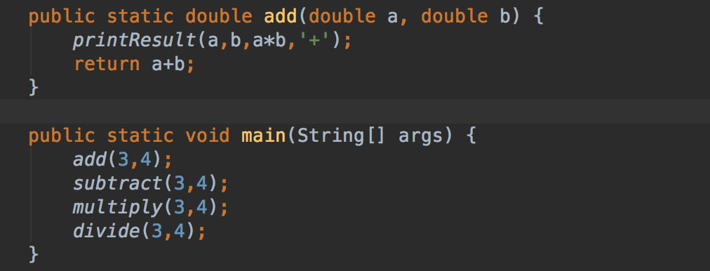
Lesson 1.8
Methods and Parameters
A method is used to abstract basic operations and give them a name.
Instead of repeating a sequence of operations again and again, just call the method

Slide 14
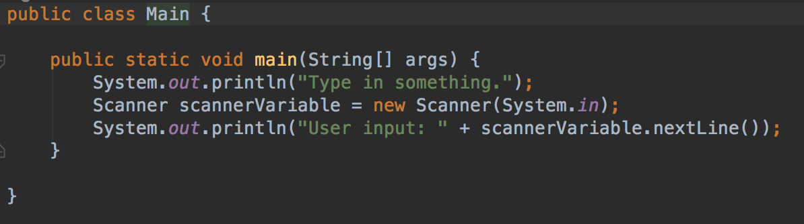
Lesson 1.9
User Input
A Scanner is a simple utility to get data from user input
System.in prompts the user for input on the command line.

Slide 15
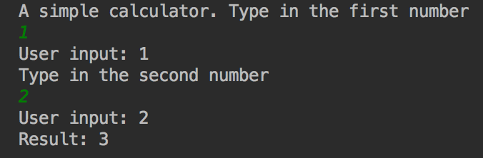
Practice 1
Write a simple calculator
Write a simple calculator that takes two user inputs and prints a result.
Use the Scanner class and parse the integers from the input.

Slide 16
Chapter 2
Decisions
If-then-else
Switch-Case
Operators

Slide 17
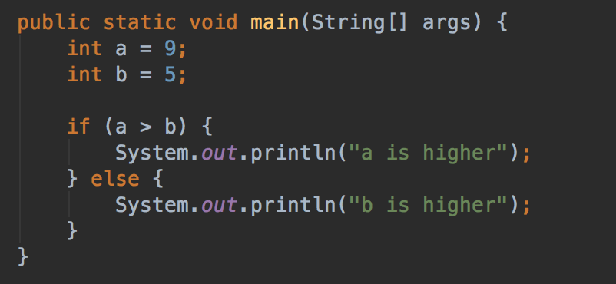
Lesson 2.1
What if, and what else?
The if clause is used for decisions
Structure: if – then – else
You can omit the curly braces, but then only first statement is executed

Slide 18
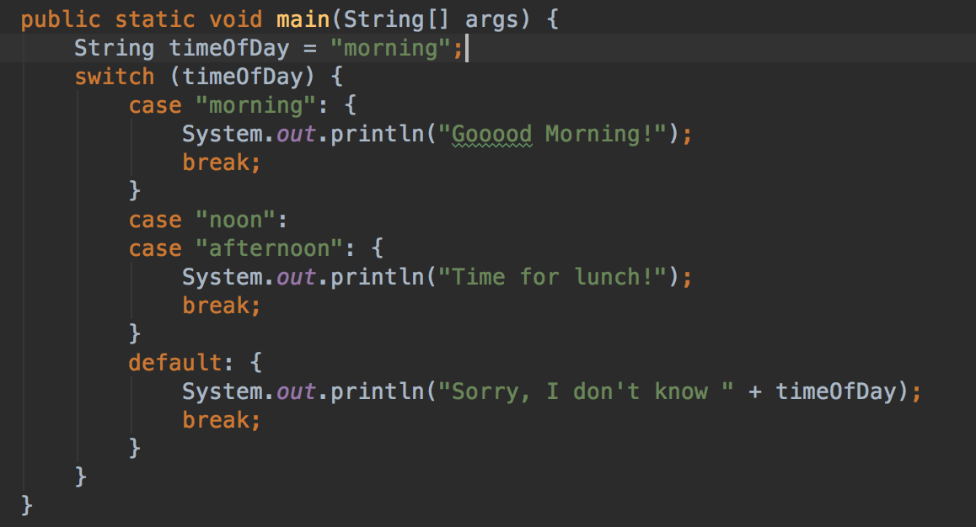
Lesson 2.2
Switch / Case
Use a switch instead of a sequence of if‘s
Structure is :
switch(variable) { case condition: { statement_1 .. statement_n } break; }
Default statement is executed if no condition meets

Slide 19
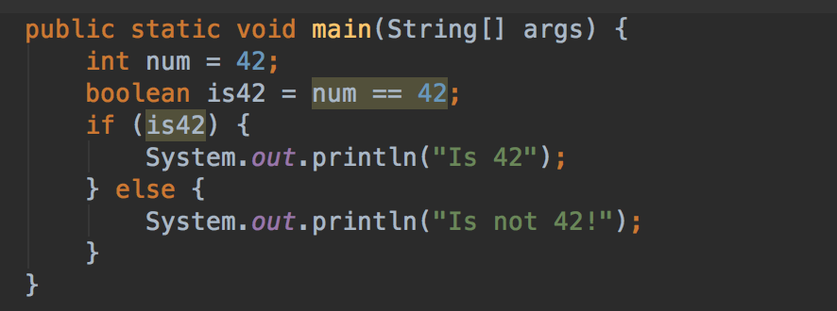
Lesson 2.3
The Boolean Operator
The boolean operator can only have two states: true or false
Uses only one bit of memory.
Can be used to store a state

Slide 20
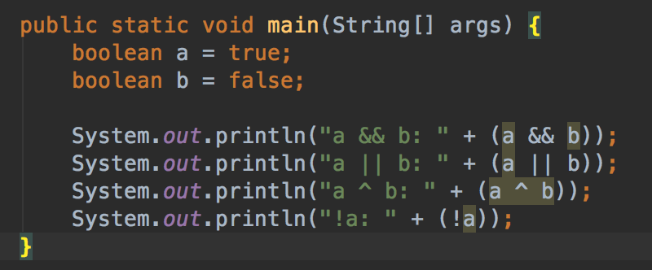
Lesson 2.4
Logical Operators
Logical operators are used to combine boolean statements
a && b: a and b are true
a || b: a or b is true or not
a ^ b: XOR: either a or b is true, but not both
!a: a is not true

Slide 21
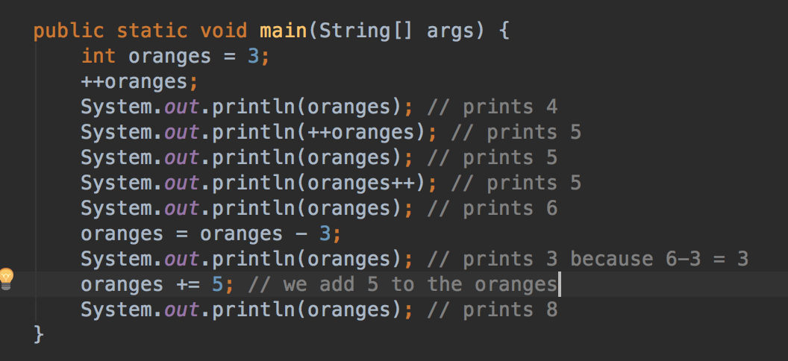
Lesson 2.5
Increment Operator
i++ is a shorthand for i = i+1
i += x is a shorthand for i = i+x

Slide 22
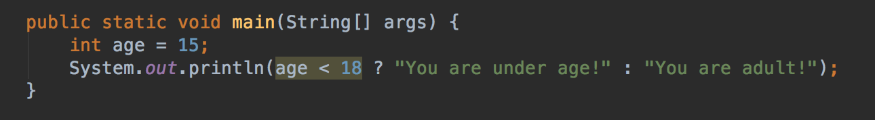
Lesson 2.6
Conditional Operator
a ? op1 : op2
is a shorthand for
If (a) {op1} else {op2};
And can be used inline:

Slide 23
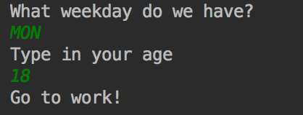
Practice 2
Write a program that makes a decision
As a user, I want to know from my program whether I should go to work, or to school, or relax.
- The user will provide the program with the weekday.
- The program prints out “Go to work” on weekdays and “Relax” on the weekend.
- Weekdays are: MON, TUE, WED, THU, FRI
- Weekends are: SAT, SUN
- Provide a message “Weekday unknown” if someone enters an invalid day.
Bonus part: let the user provide the age as well. If under 18, show “Go to school” on the weekdays instead

Slide 24
Chapter 3
Loops
Arrays
Do-While-Loops
For Loops

Slide 25
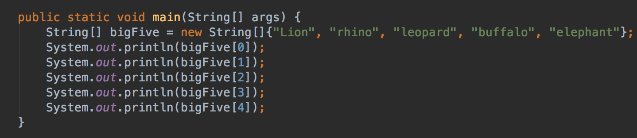
Lesson 3.1
Arrays
An Array is a data structure to store multiple values of one data type.
Has fixed size
Numbering starts with 0
String bigFive = new String[5]; would initialize empty array

Slide 26
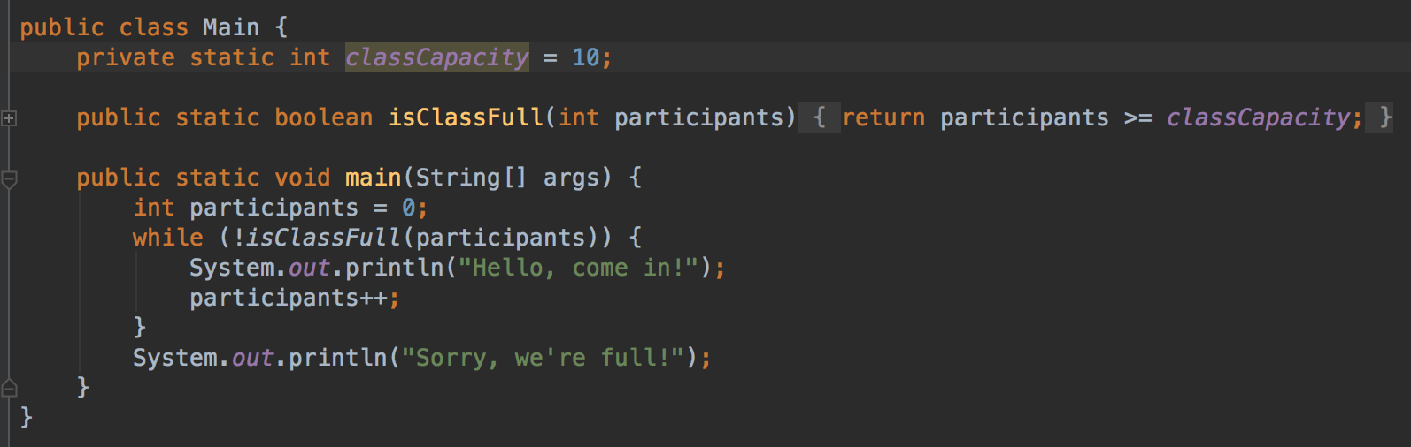
Lesson 3.2
Do-While Loops
A while loop is repeated as long as a specific condition is met
While (condition) { do; }

Slide 27
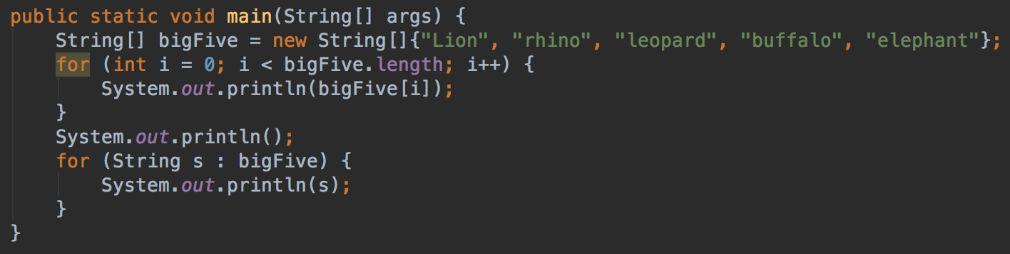
Lesson 3.3
For Loops
A for loop is repeated as long as a specific condition is met, but provides an iteration variable
for (variable; condition; iteration) { do(variable); }

Slide 28
Practice 3
Write a program that takes an array of numbers and calculates the sum of these.
The array can have any size.
Provide a method private static int sum(int[] numbers) { ... }

Slide 29
Chapter 4
Classes and Objects
Classes
JavaFX
Setters and Getters
Constructors
Error Handling
Constants

Slide 30
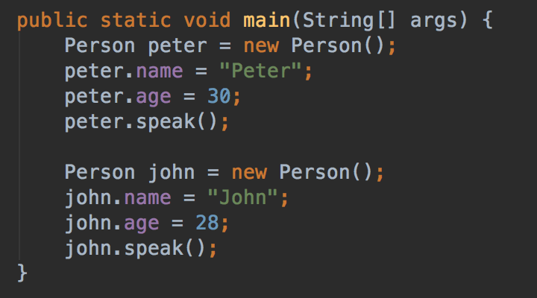
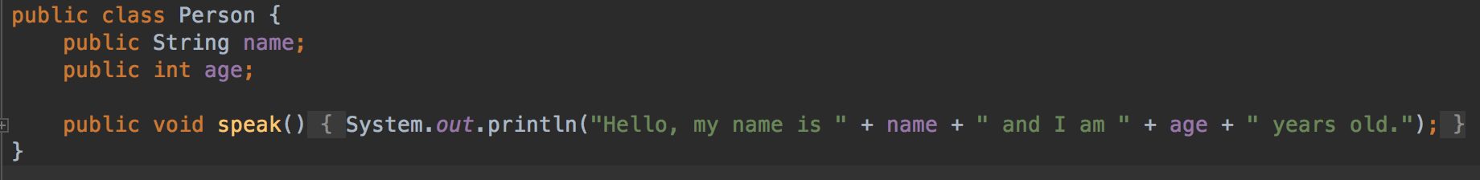
Lesson 4.1
Classes as extended Data Types
A person can have a name, an age and tell about that
Use new Person() to create a new person Object
The Java VM manages memory, so object destruction is not needed.

Slide 31
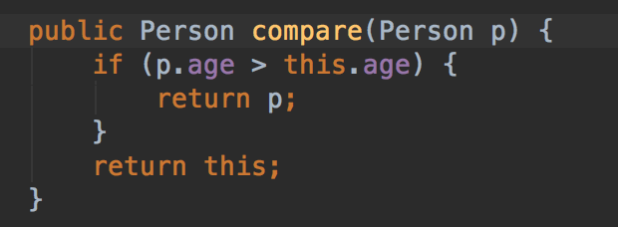
Lesson 4.2
Methods with parameters
A method can also take another object as input.
This one compare the ages of two persons

Slide 32
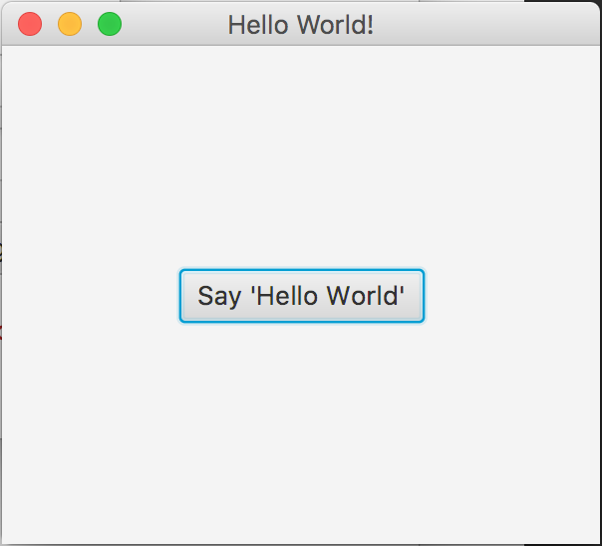
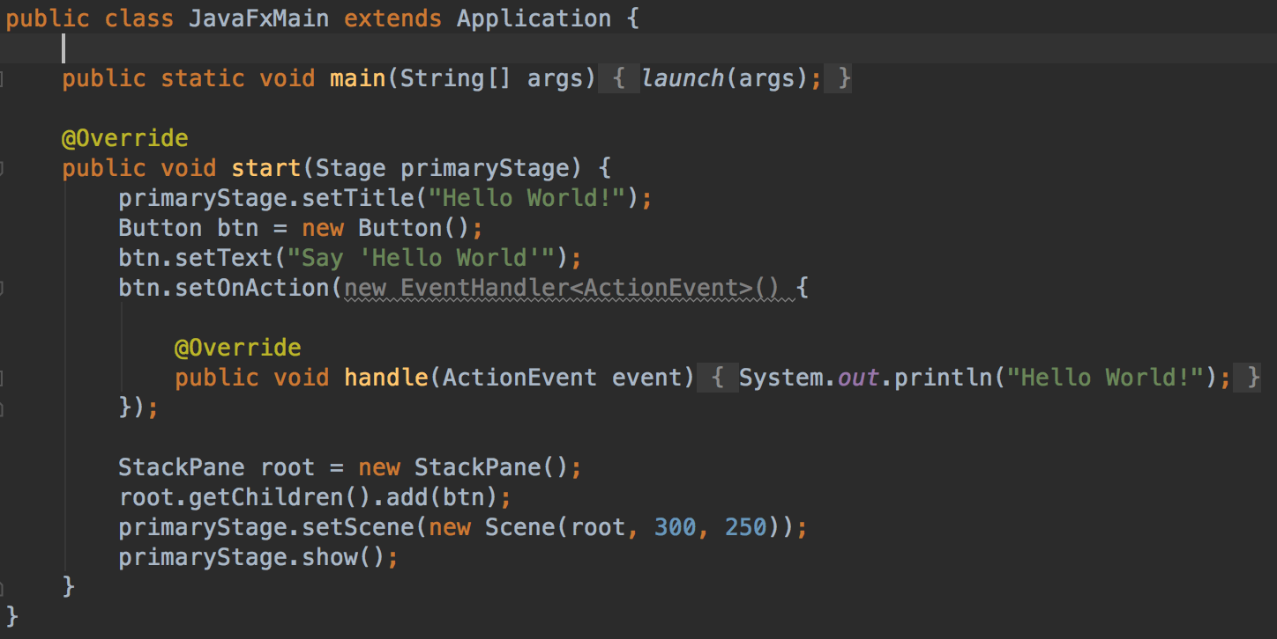
Lesson 4.3
Excurs: JavaFX

Slide 33
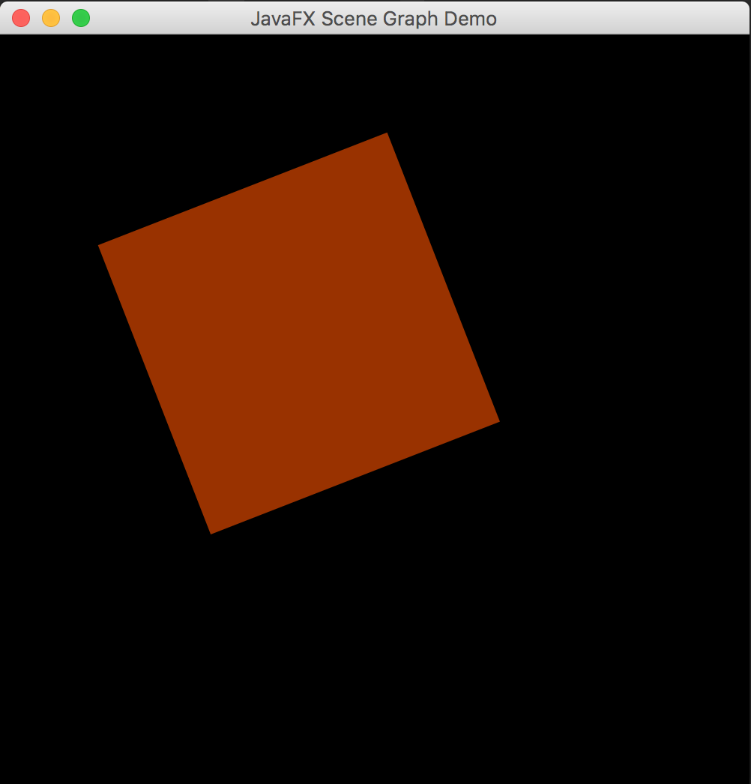
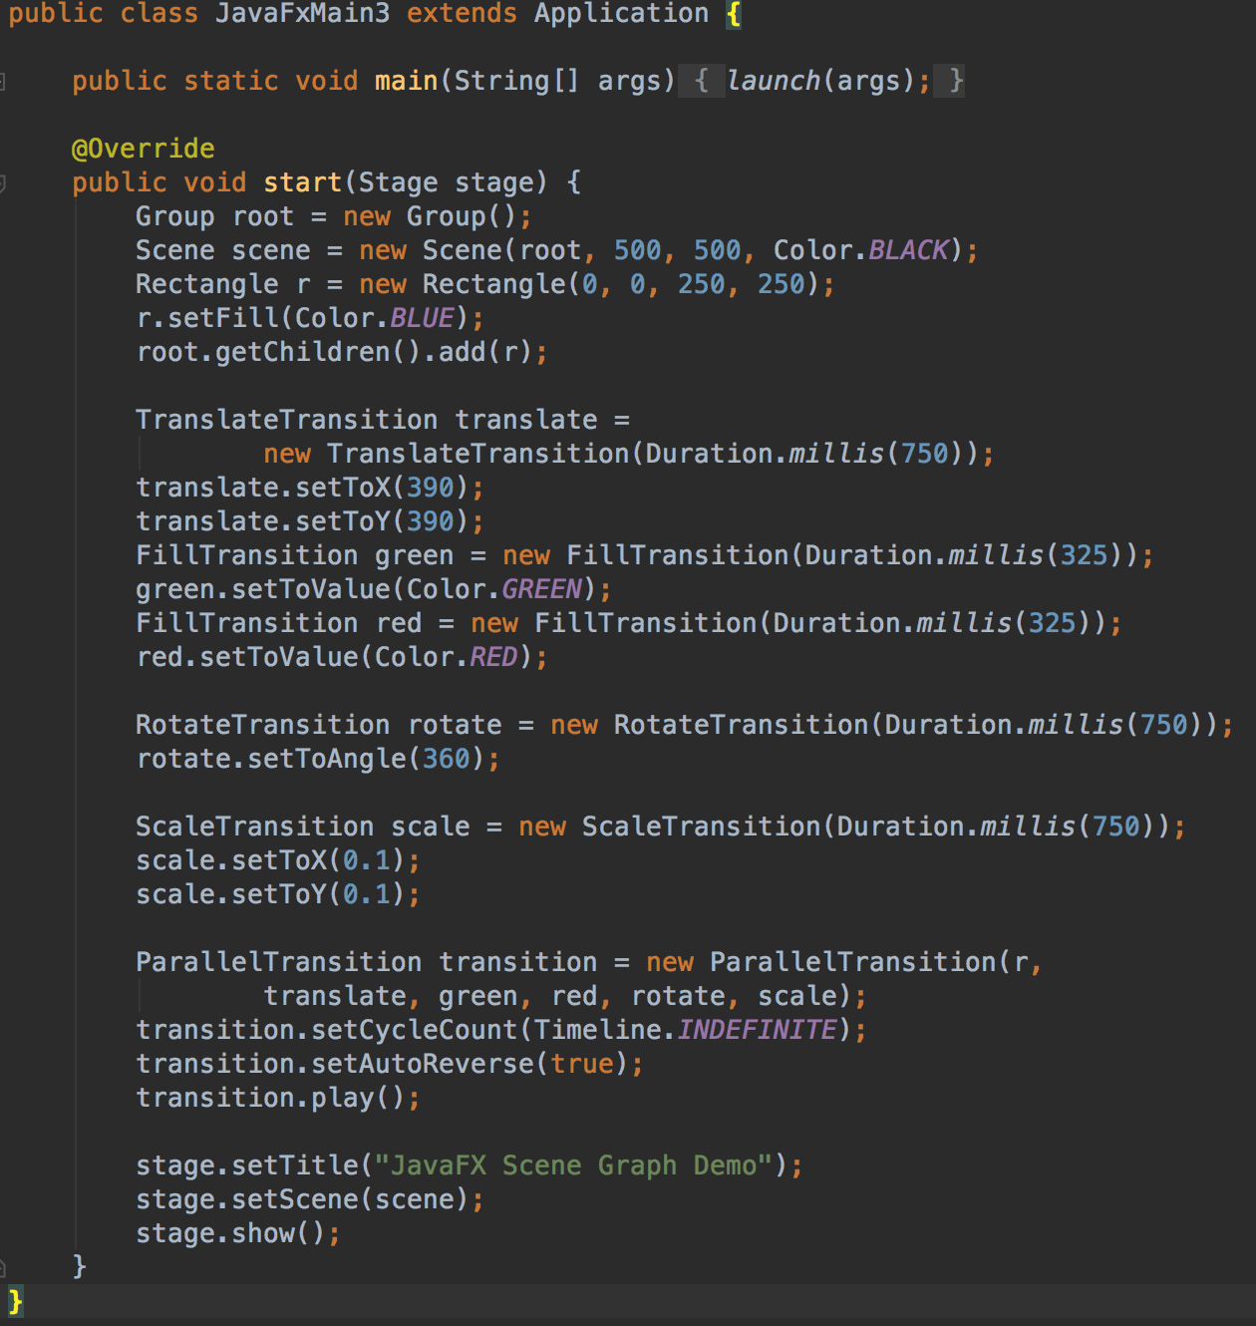
Lesson 4.3
Excurs: JavaFX

Slide 34
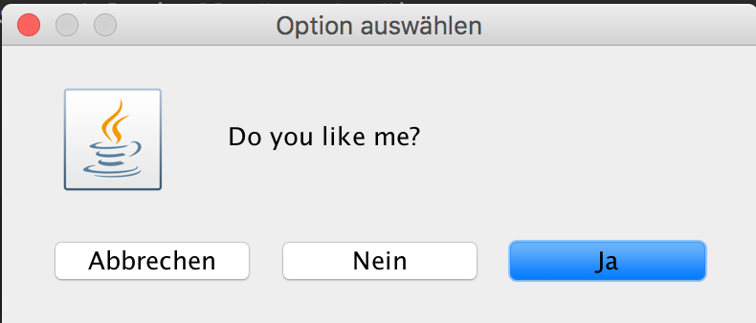
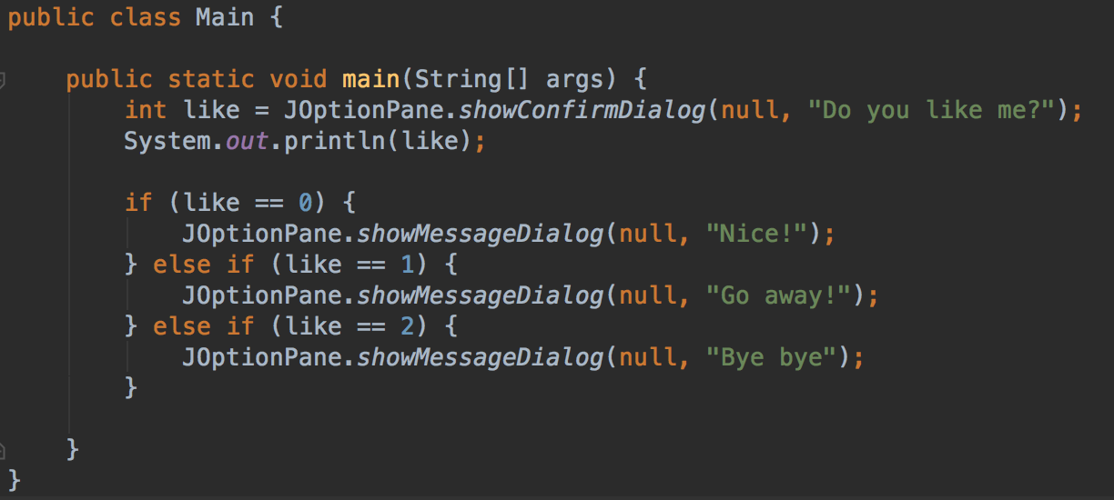
Lesson 4.3
Excurs: Swing

Slide 35
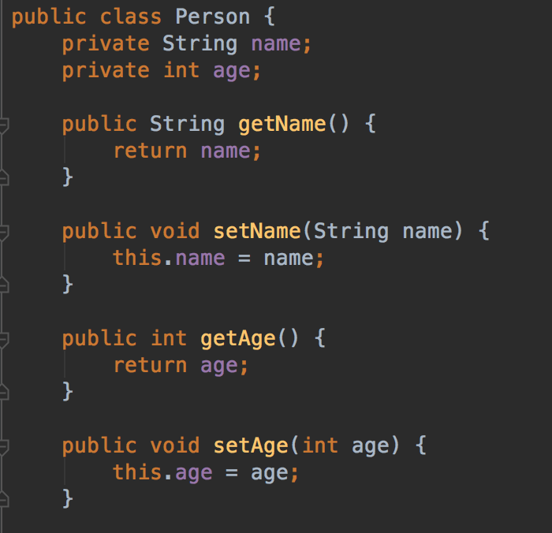
Lesson 4.4
Setter and Getter
It is a good strategy to hide variables from the outside and control access via getters and setters.
E.g. prohibit write access

Slide 36
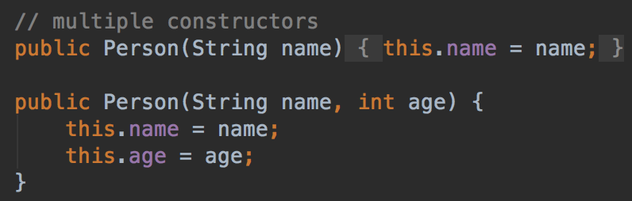
Lesson 4.5
The constructor
The constructor builds a new instance of a class.
Here, both is possible:
new Person(„John“); new Person(„John“, 26);

Slide 37
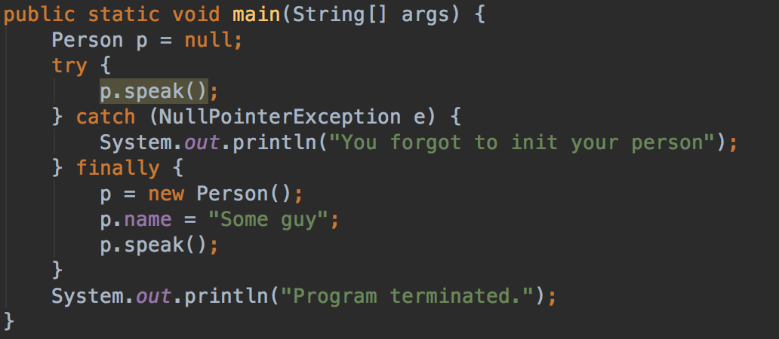
Lesson 4.6
Error Handling
Errors can result in a program stop.
The Java VM throws an Exception. Luckily, this can be caught.
try { op; } catch (Exception e) { handleException; } finally { executeAnyway; }

Slide 38
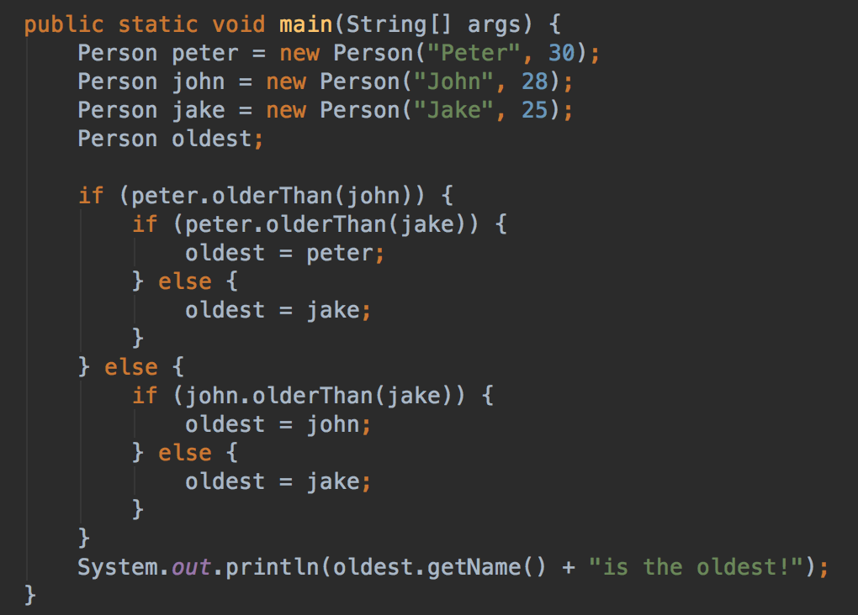
Lesson 4.7
Cascaded If’s
If‘s can be cascaded...

Slide 39
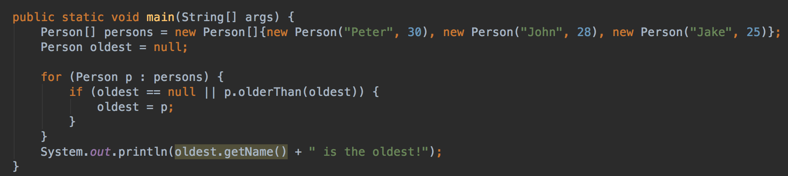
Lesson 4.7
Cascaded If’s
... But better is this one:

Slide 40
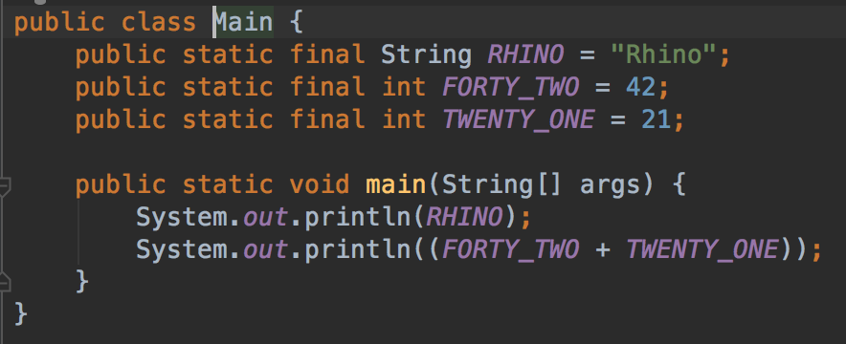
Lesson 4.8
Constants
Constant values cannot be changed.
They act as fixed values.
E.g.
PI = 3.14; ADMIN_ROLE = „admin“; ZA = „South Africa“ CHESS_SIZE = 8; LOTTO = 49;

Slide 41
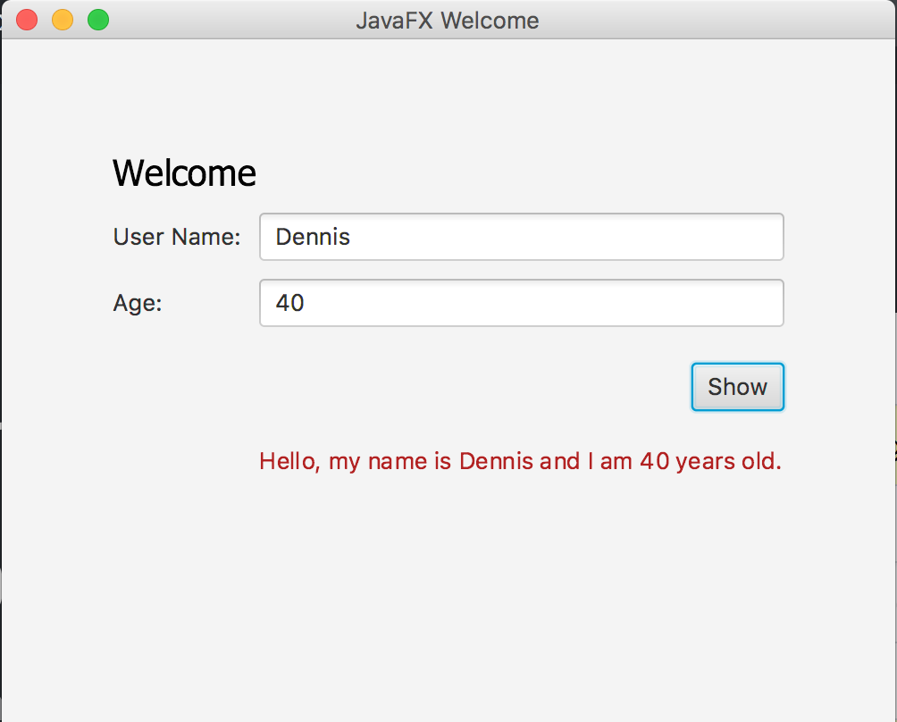
Practice 4
Complete the message dialog given in practice4 to display person data.

Slide 42
Chapter 5
More on Arrays
Modify arrays
Arrays as parameters
Multi-dimensional arrays
Math and Random
Static
Access Rights

Slide 43
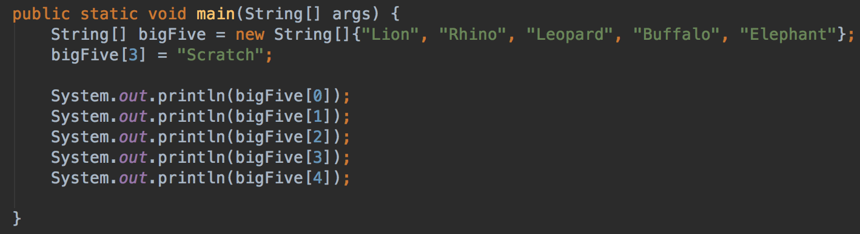
Lesson 5.1
Modify values in an array
Arrays can be manipulated by simply setting a field
bigFive[3] = „Scratch“

Slide 44
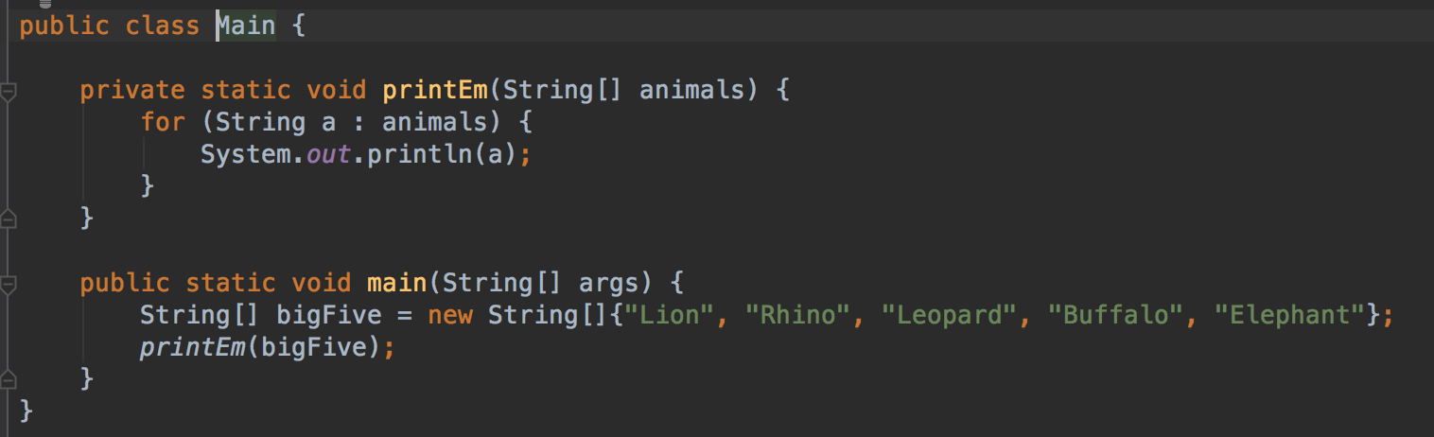
Lesson 5.2
Arrays as Parameter
Arrays can be passed as a parameter. The length does not matter.

Slide 45
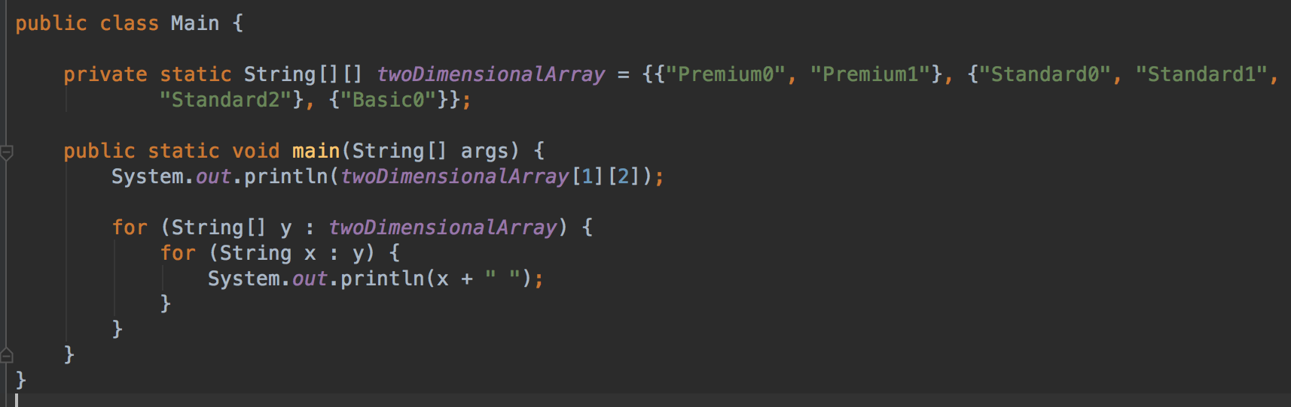
Lesson 5.3
Multi-dimensional arrays in Java
Arrays can contain other arrays.
For example, to model a chess board...

Slide 46
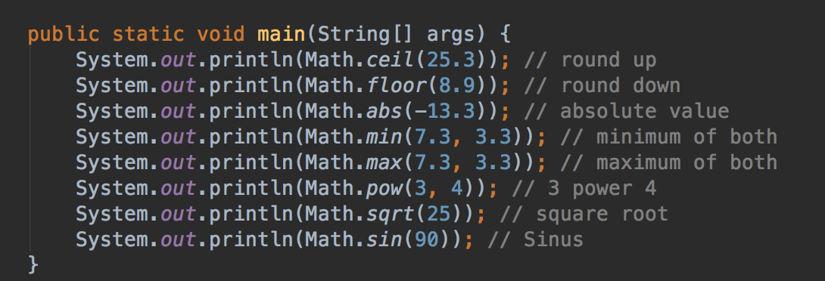
Lesson 5.4
The Math class
This is a class shipped with Java
The Math class brings advanced math operations.

Slide 47
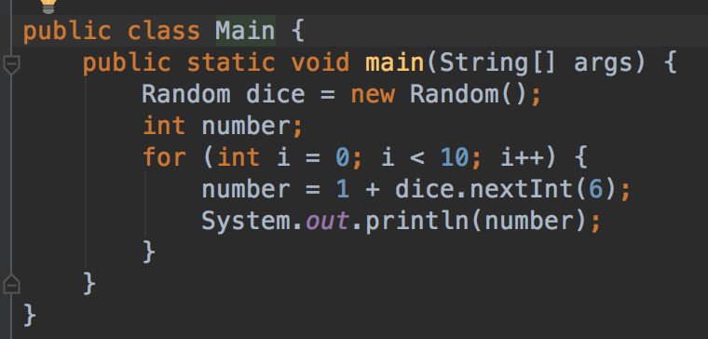
Lesson 5.5
The Random generator
Use this to generate random numbers.
Got an idea how to build a lotto game?

Slide 48
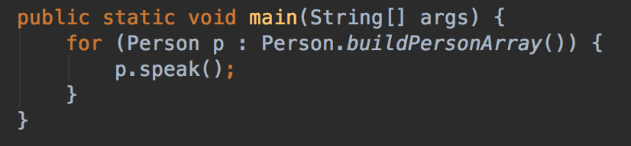
Lesson 5.6
Static
Static variables and methods do not depend on an object instance.
Even more, they can be used to build instances of their class...

Slide 49
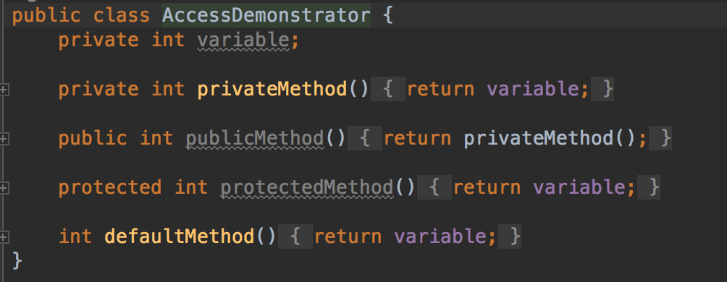
Lesson 5.7
Private, Public, Protected: Access restrictions
Variables can have different visibilities.
private: hidden to the outside public: completely visible protected: visible in hierarchy default: visble in package

Slide 50
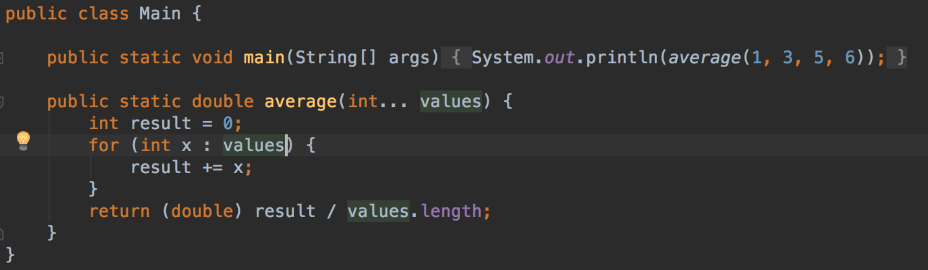
Lesson 5.8
Parameter Lists
The ellipses operator defined a list of parameters from one type, where the length is not set
Must be at the end of the parameter declaration.
Internally handled as an array.

Slide 51
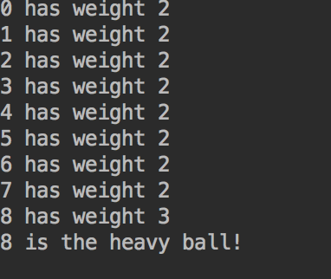
Practice 5
Ball weight game preps: write the data model
This shall become a game with the following rules:
The player sees 9 balls/ circles. Use an array.
One of the balls is heavier than the others.
Use two constants SMALL_WEIGHT = 2 and HEAVY_WEIGHT = 3
Write a method that randomly selects one ball and makes it heavier.
Write a method that finds the heavier ball and prints it‘s array id on the console.

Slide 52
Chapter 6
Inheritance and Polymorphism
Inheritance
Polymorphism
Interfaces
Comparators

Slide 53
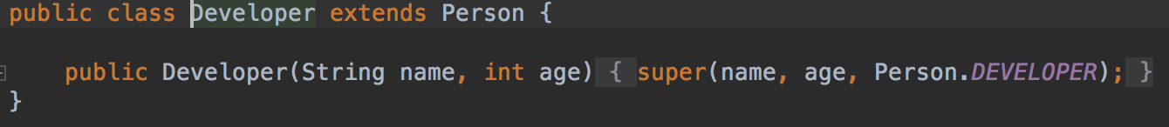
Lesson 6.1
Inheritance with extends
A class can extend another class
It has then all variables and methods.
Only protected or public variables/ methods can be redefined
Here, a Developer is a person.

Slide 54
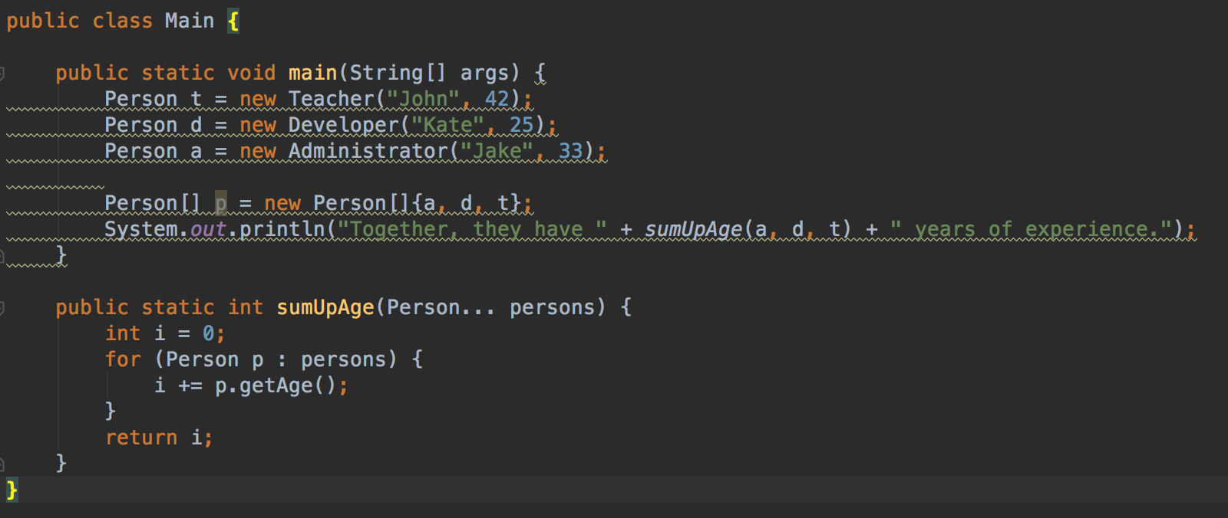
Lesson 6.2
Polymorphism
The sumUpAge() method expects a Person instance. You can put in a Developer, Teacher, Student ...

Slide 55
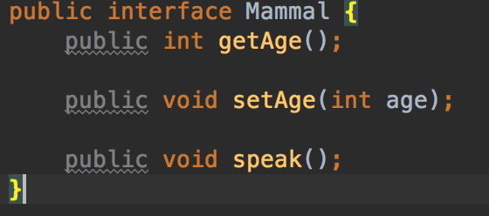
Lesson 6.3
Interfaces
An interface is a template for classes.
Classes have to implement the interface.
Interfaces are contracts for reusability.

Slide 56
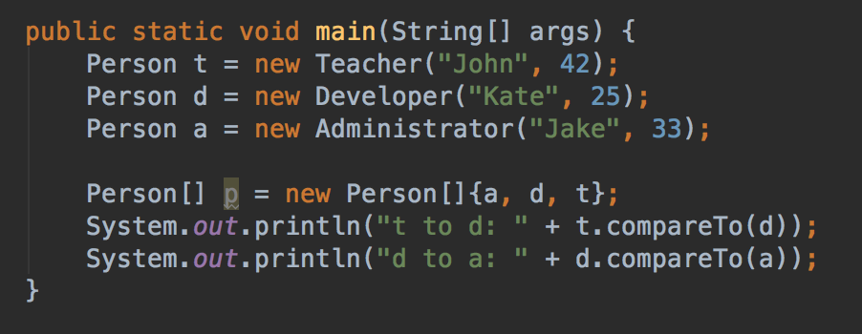
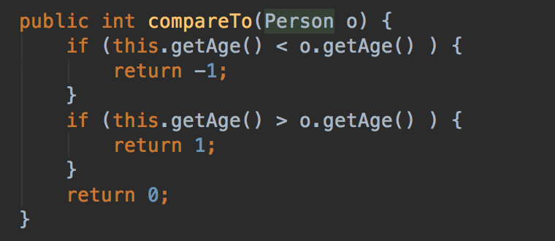
Lesson 6.3
Comparators
Make objects comparable

Slide 57
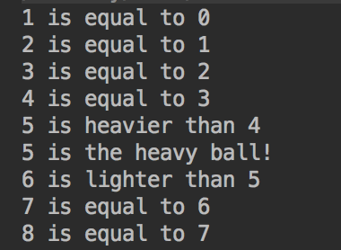
Practice 6
Write a comparator for the balls data type from practice 5.

Slide 58
Chapter 7
More features
Final
Abstract
toString()
Composition
Boxed Types
Enumerations
Object References and Memory Leaks
equality

Slide 59



Lesson 7.1
final
Final declares variables and classes as non-changeable.
It is not possible to derive from final classes

Slide 60

Lesson 7.2
abstract
An abstract class is a template that cannot be instantiated.

Slide 61

Lesson 7.3
toString()

Slide 62

Lesson 7.4
Composition

Slide 63

Lesson 7.5
Boxed Types

Slide 64

Lesson 7.6
Enumeration
An enum defines the possible states a data type can have.
Can be used like a normal data type.
E.g. Flight state: WAITING, STARTING, FLYING, ARRIVING, LANDED, UNLOAD, DELAYED

Slide 65


Lesson 7.6
Enumeration

Slide 66

Lesson 7.7
Object References
Be careful with object references!
In this example, simply setting the teacher does not affect the student object!
Even worse, the student references an „abandoned“ teacher.
The Garbage Collector cannot clean up the teacher object.
This is a memory leak!

Slide 67

Lesson 7.8
equals()
Object equality is a two-faced thing:
The ==-Operator checks the object reference, thus the identity
==: objects are identical
Equals: objects have equal properties

Slide 68

Practice 7
Congrats! You made it through the Java basics course!
To challenge you, we want you to write a game:
This is actually a math riddle: you have nine balls (or marbles). One of them is heavier than the others. You have a balance weight to weigh them out and are given two tries.
We won‘t use a balance weight, but two colors: Green and Red.

Slide 69

Practice 7
We won‘t use a balance weight, but two colors: Green and Red.
Once two groups of balls are selected, you can compare their weight by clicking the button.

Slide 70

Practice 7
We won‘t use a balance weight, but two colors: Green and Red.
Once two groups of balls are selected, you can compare their weight by clicking the „Show Weight“ button.
You can do this only twice. Then the „Show Weight“ button will disappear and you have to click on the heaviest ball. If you cannot find it, the Game is over.
Solution will be provided in two weeks on GitHub!

Slide 71
Chapter 8
Maven

Slide 72
Chapter 9
Testing

Slide 73
Lesson 9.1
Why Testing?

Slide 74
Lesson 9.2
The JUnit Framework

Slide 75
Lesson 9.3
A simple test

Slide 76
Lesson 9.3
Test-Driven Development

Slide 77
Practice 9

Slide 78
Chapter 10
Working with Spring Boot

Slide 79
Lesson 9.1
The spring.io Website

Slide 80
Lesson 9.2
The spring.io Guides

Slide 81
Lesson 9.3
Building a REST Service

Slide 82
Practice 9

Slide 83
Chapter 10
Java 8

Slide 84
Lesson 8.1
What is new in Java 8?

Slide 85
Lesson 8.2
Lambda Expressions

Slide 86
Practice 9

Slide 87
Further Learning
Patterns
Spring Boot
Test Driven Development
Android

